Slide 1

School Activity Booking and Management System
CN7021 – Advanced Software Engineering Project (Flask Framework)

Slide 2
Project Overview
Purpose: Provide an online portal for parents to book after-school activities, manage tutors, and receive PDF invoices.
Framework: Flask (Python)
Database: SQLite Front-End: HTML + CSS (Bootstrap)
Main Features:
• Secure login and registration
• CRUD for activities and tutors
• Booking validation (one per day)
• Automatic PDF invoice generation

Slide 3
System Architecture
User → Flask App → SQLite DB → ReportLab (PDF)
├ auth (login/register)
├ activities (CRUD)
├ bookings (logic)
└ invoices (PDF)

Slide 4
Individual Contributions
Student | Module | Description
Sanchit Kaushal | Authentication | Registration, login/logout with password hashing
Sharjeel Khan | Activities | CRUD for activities and tutors
Chichabendu Umeh Blessed | Bookings | Booking logic and conflict prevention
Shiva Kasula | Invoices | PDF invoice generation using ReportLab

Slide 5
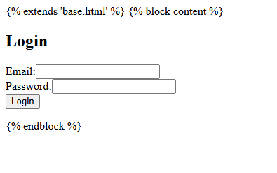
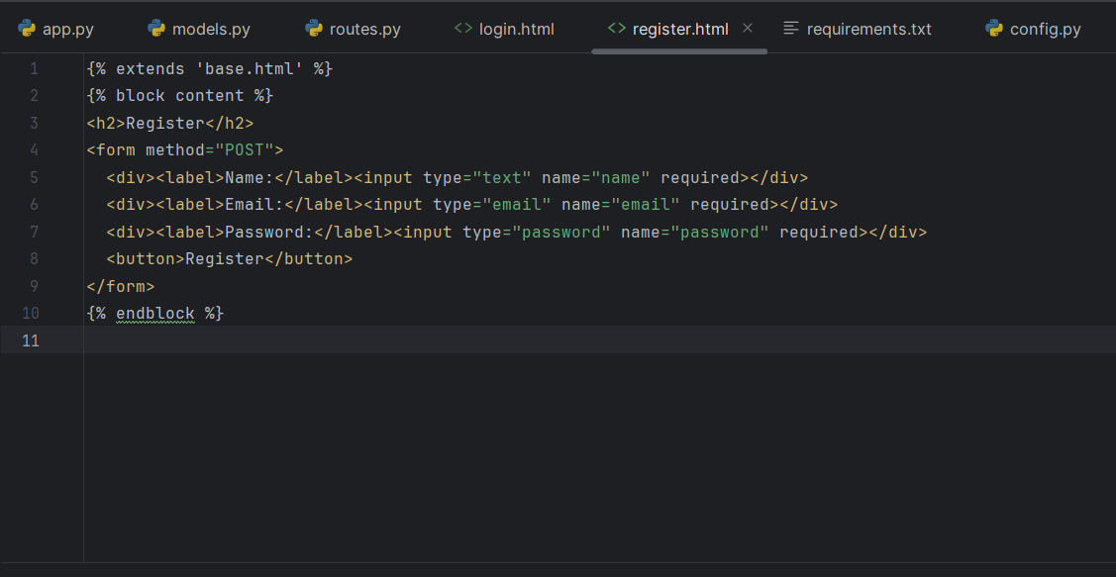
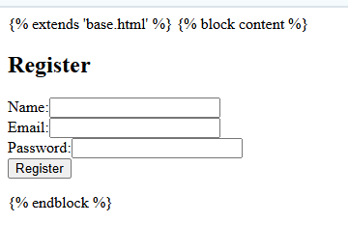
Code & Output

Slide 6
Features to be added
•Booking confirmation
•Dynamic UI
•Tutor Details
•

Slide 7
THANK YOU

